Slide 1
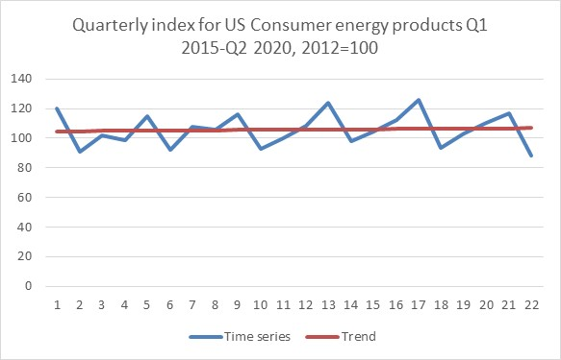
Time series data - Long term forecasts and seasonality
Seasonality?
Forecasting and Errors?
The aim of this chapter is to provide the reader with a set of tools which can be used for time series analysis and extrapolation. This chapter will allow you to apply several time series methods for long-term forecasting and extrapolation.

Slide 2
Learning Objectives
On completing this unit, you should be able to:
Part 1 Trend
Understand the time series fundamentals.
Be able to inspect and prepare data for forecasting.
Graph the data and visually identify patterns.
Fit an appropriate model using the time series approach.
Use the identified model to provide an extrapolation.
Calculate a measure of error for the model fit to the data set.
Learn how to calculate prediction interval.
Solve problems using the Microsoft Excel and SPSS.
Part 2 Seasonality
Learn how to handle seasonal time series and apply the decomposition method.
Solve problems using the Microsoft Excel and SPSS.

Slide 3
Part 2 Seasonality and Decomposition in classical time series analysis
We started this chapter with a simplified model. We stated that if we are interested in forecasting the long-term future of a data set, all we have to do is to assume that data set consists of only two components.
Equation (10.1) stated that the first component is just a trend and everything else is treated as a residual.
The residual was the second component. In other words, if we can produce a good trend line (linear or any curve), and fit it to our data, the difference between the historical values of the time series and the trend should be considered as residuals.
These residuals, we also learned, need to be randomly fluctuating around this trend line. If they are not, then the trend does not represent (or fit) the time series well and it is a wrong forecasting model. Sometimes no matter what we do, these residuals are not random.
Why? We’ll use an example to explain why.

Slide 4
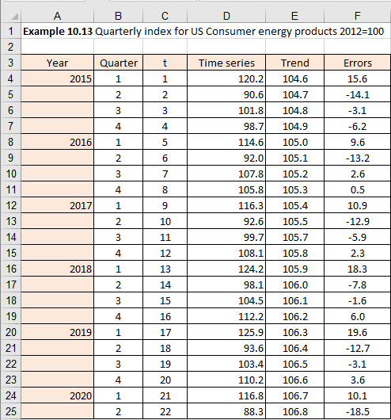
Example 10.13 (1/4)
We will look at a real-life time series, which happens to be Quarterly index for US Consumer energy products from Q1 2015 until Q2 2020, where 2012=100. We are showing in Figure 10.52 and 10.53 the time series and the trend we fitted to it (calculations not shown).

Slide 5
Example 10.13 (2/4)
We can see that the linear trend was appropriately selected, but when we plot the errors, as in Figure 10.53, we realise that something else must be embedded in our actual data.
Figure 10.53

Slide 6
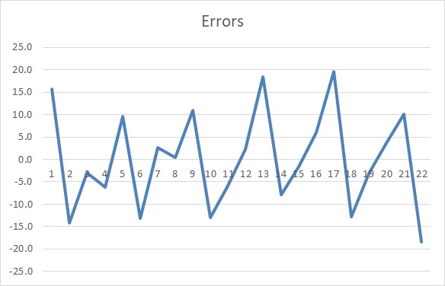
Example 10.13 (3/4)
No matter what curve we picked, there seems to be some other regularities pulsating in our time series, which means that a simple trend method will not be enough to model such time series.
If there are other components embedded in our historical time series, then these components are preventing us from incorporating them into the forecasting model by using this simplistic approach.
We all intuitively know that the sales of ice cream will have a strong seasonal component. General retail sales, we also know, has a strong seasonal component, showing strong peaks around Christmas time, for example.
Figure 10.54

Slide 7

Example 10.13 (4/4)
The classical time series analysis starts with an assumption that every time series can be decomposed into four elementary components:
Underlying Trend (T)
Cyclical variations (C)
Seasonal variations (S)
Irregular variations (I)
Additive model
10.19
Multiplicative model
10.20
Mixed model example
10.21
A method of isolating different components in a time series or, decomposing the time series as we will do here, is called the classical time series decomposition method. This is one of the oldest approaches to forecasting. The whole area of classical time series analysis is concerned with this theory and practise of how to decompose a time series into these components. Once you have identified the components and estimated them, you then recompose them to produce forecasts.

Slide 8
Cyclical component (1/9)
To illustrate a simple method of extracting the cyclical component, we will use data from Encyclopaedia of Mathematics that shows the number of the Canadian lynx "trapped" in the Mackenzie River district of the North-West Canada for the period 1878–1931. In fact, the time series is even longer and covers 1821-1834 (https://www.encyclopediaofmath.org/index.php/Canadian_lynx_data).
Year | No. | Year | No. | Year | No. | Year | No. | Year | No.
1878 | 299 | 1889 | 39 | 1900 | 387 | 1911 | 1388 | 1922 | 399
1879 | 201 | 1890 | 49 | 1901 | 758 | 1912 | 2713 | 1923 | 1132
1880 | 229 | 1891 | 59 | 1902 | 1307 | 1913 | 3800 | 1924 | 2432
1881 | 469 | 1892 | 188 | 1903 | 3465 | 1914 | 3091 | 1925 | 3574
1882 | 736 | 1893 | 377 | 1904 | 6991 | 1915 | 2985 | 1926 | 2935
1883 | 2042 | 1894 | 1292 | 1905 | 6313 | 1916 | 3790 | 1927 | 1537
1884 | 2811 | 1895 | 4031 | 1906 | 3794 | 1917 | 674 | 1928 | 529
1885 | 4431 | 1896 | 3495 | 1907 | 1836 | 1918 | 81 | 1929 | 485
1886 | 2511 | 1897 | 587 | 1908 | 345 | 1919 | 80 | 1930 | 662
1887 | 389 | 1898 | 105 | 1909 | 382 | 1920 | 108 | 1931 | 1000
1888 | 73 | 1899 | 153 | 1910 | 808 | 1921 | 229
Example 10.15

Slide 9
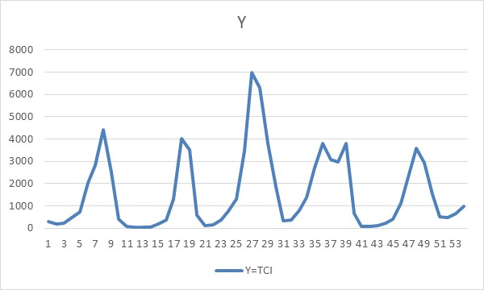
Cyclical component (2/9)
The time series consists of 54 observations and when we plot it, it looks as in Figure 10.56.
This appears to be a cyclical time series, so we will now apply the classical decomposition principles and calculations in Excel (rows 11 to 47 are hidden). The graph in Figure 10.56 indicates a repeating pattern approximately every 9 years, so the length of the lynx trapping cycle is 9 years.
Figure 10.56

Slide 10
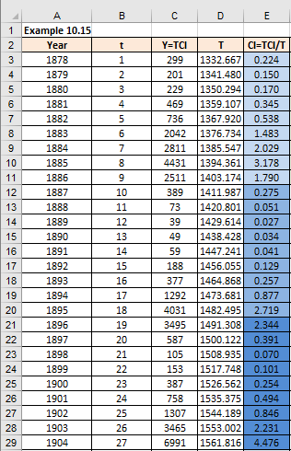
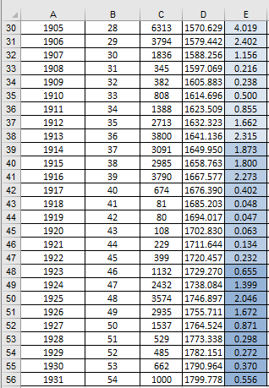
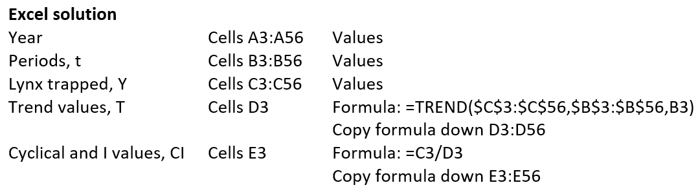
Cyclical component (3/9)

Slide 11
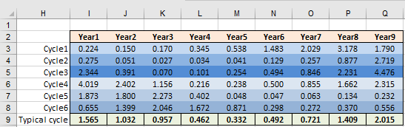
Cyclical component (4/9)
To understand some of the calculations above, we will need another table, as per Figure 10.58.

Slide 12
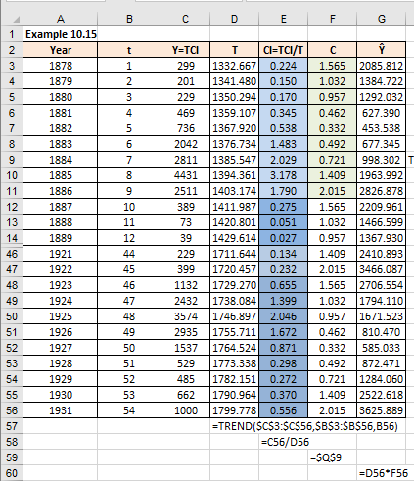
Cyclical component (5/9)
Now calculate the cyclical component C and the model forecast value (row 15:45 hidden)
Figure 10.59
We decided that 9 years is the periodicity of this time series by just observing the graph. There are other more accurate methods, such as autocorrelations, that can be used to decide precise periodicity, but they are beyond the scope of this textbook.

Slide 13
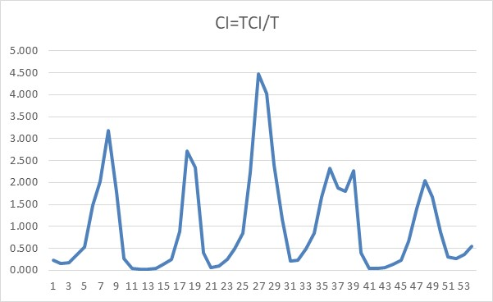
Cyclical component (6/9)
Column C in Figure 10.59 shows the number of lynx trapped per year (Y). The data are annual, so according to the principles of time series decomposition, they contain three components: T, C and I. We need to isolate the trend (T) component first. We achieved this in column D. This was calculated using Excel function =TREND().
To eliminate the trend value from the data Y, we need to divide the historical values Y (column C in Figure 10.59) with the trend data T (column D in Figure 10.59). The result is the cyclical component (C) entangled with the irregular component (I) (column E in Figure 10.59). This component is shown in Figure 10.60.
Figure 10.60

Slide 14
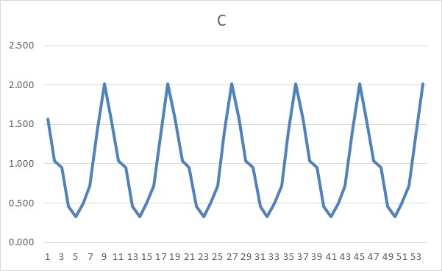
Cyclical component (7/9)
To eliminate the irregular component and get just the cyclical component, we need to look at calculations from Figure 10.59. As the cycle length is 9 years, we copied cells from column E in blocks of 9 into row 3 (I3:Q3), we continued to copy these blocks of nine, until we exhausted all the values from column E in Figure 10.59. This table in cells I3:Q8 shows all identical cycles in every column (see Figure 10.61).
Underneath every cycle, in cells I9:Q9 we then calculated an average value for every cycle. As we are now eliminating all the variations within every cycle, this average value for every cycle now becomes a typical cycle value. In other words, by averaging all values in every cycle, we have eliminated the Irregular component. What we have in I9:Q9 is a pure C component. Figure 10.61 shows this C component (column F in Figure 10.59).
Figure 10.61

Slide 15
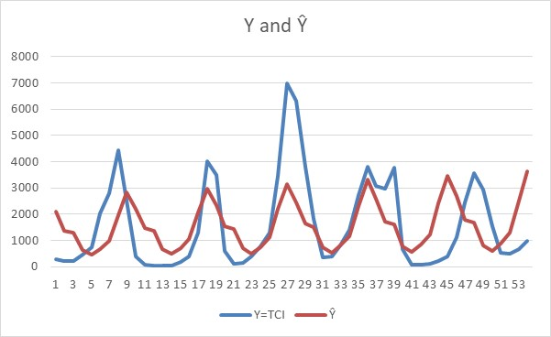
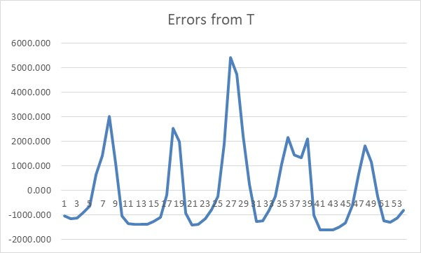
Cyclical component (8/9)
What is left now is to recompose the time series and to see how it fits the historical data. Figure 10.62 shows the original data and the fitted values Ŷ (G in Figure 10.59). As the value of C is effectively an index number oscillating around 1, all we have to do is to multiply every trend value T with its corresponding cycle value C.
As we can see our model does not fit the actual data perfectly well. However, it is much better than a simple trend line fitted to data. We will learn later how to improve the model. If we used only trend as a model and then calculated the errors, or residuals, we would get the chart that looks as Figure 10.63.

Slide 16
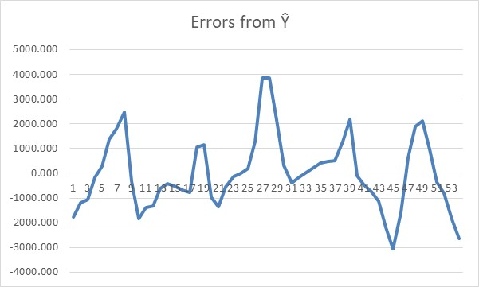
Cyclical component (9/9)
The errors calculated from the model constructed through the decomposition method look as in Figure 10.64. Clearly the errors in Figure 9.56 show strong pattern, indicating that the model is not adequate, whilst the errors in Figure 10.64 have a less of a pattern, indicating that we could have improved even more. Classical decomposition method makes sense if we have a strong cyclical or seasonal time series and we will make further improvements as we proceed through this section and the following chapter.

Slide 17
SPSS solution
SPSS has an option for time series decomposition, and it is called Seasonal Decomposition, under the Forecasting sub-menu of Analyze tab. However, the same method is used for both cyclical and seasonal data, so we will defer to show how to use it after we covered seasonal data below.

Slide 18
Seasonal component (1/11)
The above example applied to the cyclical component. If we had a seasonal component only, we can use the same technique. Other more complex, and more accurate, techniques exist, but they are beyond the scope of this textbook.
To demonstrate how to isolate the seasonal component specifically, we will use an example that contains quarterly data.

Slide 19
Seasonal component (2/11)
Example 10.16
Year | Quarter | Y
2013 | 1 | 114.5
 | 2 | 96.5
 | 3 | 103.1
 | 4 | 108.2
2014 | 1 | 121.8
 | 2 | 93.9
 | 3 | 99.7
 | 4 | 104.5
2015 | 1 | 123.7
 | 2 | 92.8
 | 3 | 105.9
 | 4 | 99.6
2016 | 1 | 116.5
 | 2 | 91.9
 | 3 | 110.4
 | 4 | 102.6
2017 | 1 | 115.0
 | 2 | 93.9
 | 3 | 101.7
 | 4 | 106.6
2018 | 1 | 122.8
 | 2 | 97.8
The data set used represents quarterly index number for the US consumer energy products, based on 2012=100 (same as Example 10.13). As before, we will use Excel first to show the calculations.

Slide 20
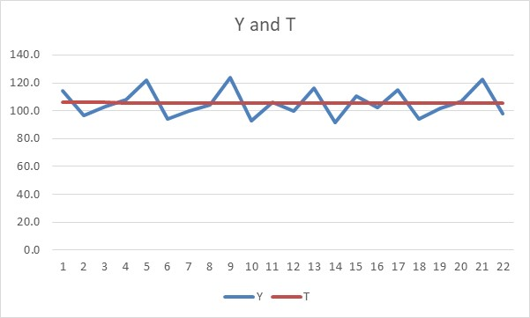
Seasonal component (3/11)
Figure 10.65 illustrates the data graph with a trend line fitted to the data set.

Slide 21
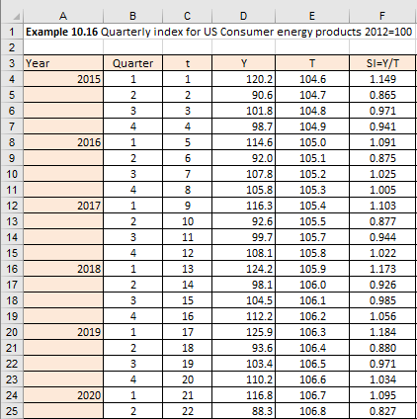
Seasonal component (4/11)
Figure 10.66 and 10.67 show the table covering period from 2013 until 2018 (column A). Every year is broken into four quarters (column B) and the whole-time series is only 22 observations long (column C). The values of the time series are given in column D. Figure 10.66 shows some calculations that we will explain in a moment.

Slide 22
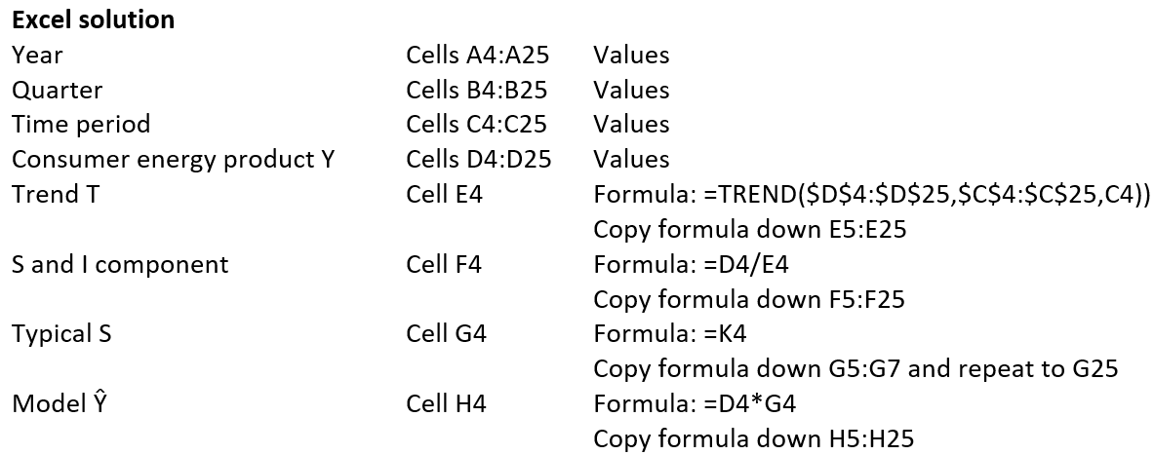
Seasonal component (5/11)

Slide 23
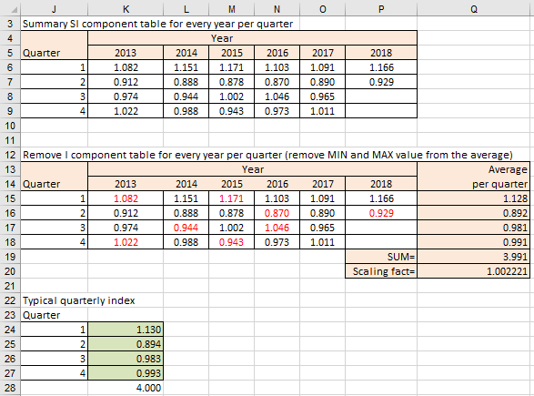
Seasonal component (6/11)
Calculate seasonal components

Slide 24
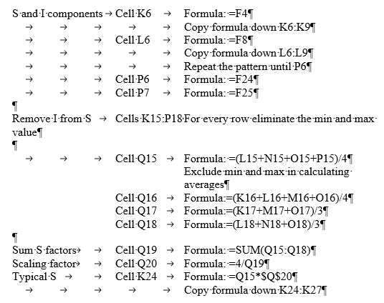
Seasonal component (7/11)

Slide 25
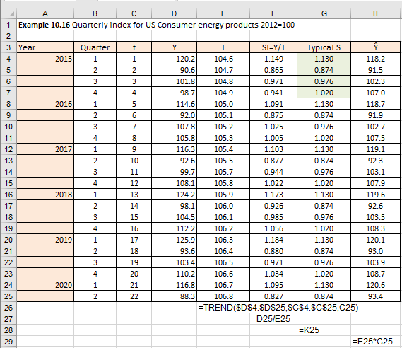
Seasonal component (8/11)
Now calculate the forecast values for each time point
Figure 10.68

Slide 26
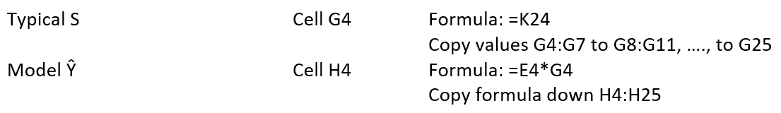
Seasonal component (9/11)
How we calculated the values up to column F in Figure 10.66, is identical to the calculations we did in Example 10.15. The only difference is that in this Example 10.16 we are handling seasonal components and in Example 10.15 we handled cyclical components. Because this time series in Example 10.16 consists of quarterly data, the seasonality present is clearly based on four quarters in the year. In Figure 10.67 in cells K6:P9 we can see how the data from column F in Figure 10.66 was transposed in the appropriate cells.
The next step, which are the cells K15:P18, are identical to the previous range K6:P9, with one difference. In every row of this little table, and every row corresponds to one quarter, we have “greyed out” the min and the max value in this row. This helps us to eliminate possible extremes that might be recorded during this quarter over the range of years. After we excluded min and max value per row, we calculate the average value for the remaining cells.

Slide 27
Seasonal component (10/11)
These average values for every quarter are given in cells Q15:Q18. The sum of the average values per quarter in cells Q15:Q18 should add up to 4 (because they are like index numbers per quarter and four quarters times 1 should be 4). However, as we can see in cell Q19, they add up to 3.997. This means we need to come up with a correction, or scaling, factor, which is given in cell Q20.
Once we have a scaling factor, we can calculate the final values for every quarter, and this is given in cells K24:K27. They are calculated by multiplying every seasonal factor from Q15:Q18 with the scaling factor from Q20. What we get are the typical quarterly indices for this time series. These typical indices are then copied into column G in Figure 9.60. From there, we return to column H in Figure 10.67. This column represents the model estimates Ŷ and they are calculated by multiplying the trend value values in column E with the typical seasonal indices in column G. The result is the re-composed time series and it represents the fit, or model values, for our time series. You can see the result in Figure 10.69.

Slide 28
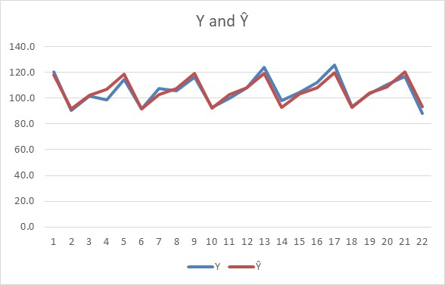
Seasonal component (11/11)
How well this time series models actual data is established if we measure the differences between the actual values in column D from the fitted values in column H in Figure 10.68. In fact, we can also apply some of the lessons from the linear regression chapter.
Figure 10.68

Slide 29
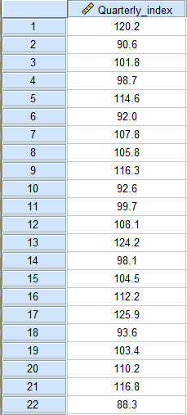
SPSS solution (1/9)
Enter series data into SPSS

Slide 30
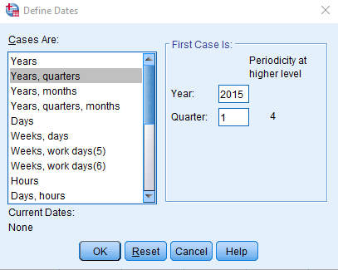
SPSS solution (2/9)
Set time series (2015 Q1 – 2020 Q2)
We enter data into SPSS, which is Quarterly index for US consumer energy products from 2015 Q1 until 2020 Q2 (2012=100). Before we proceed, we need to assign date labels to data.
Select Data > Define data and time
Figure 10.71
Click OK

Slide 31
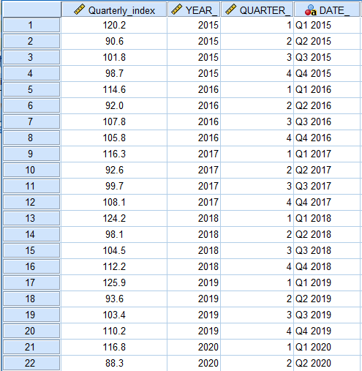
SPSS solution (3/9)
The time data will then be added to the SPSS data file as illustrated in Figure 10.72.
Figure 10.72

Slide 32
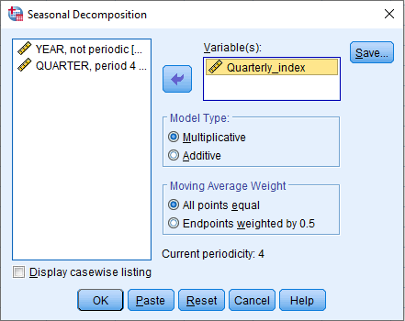
SPSS solution (4/9)
Run the SPSS test: Seasonal Decomposition
Analyze > Forecasting > Seasonal Decomposition
Transfer variable Quarterly_index in to the Variable(s): box
Figure 10.73
Click OK

Slide 33
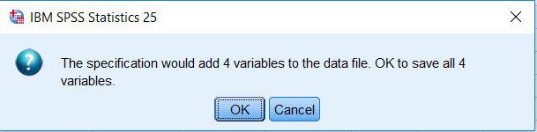
SPSS solution (5/9)
The message will appear warning that 4 new variables will be added to the data set.

Slide 34
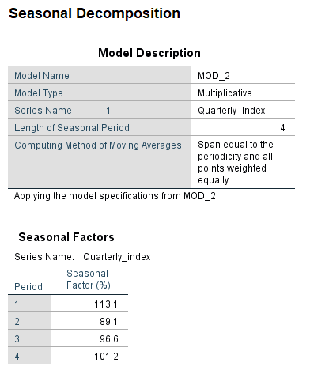
SPSS solution (6/9)
SPSS Output
After we clicked OK, SPSS provides several outputs. Figure 10.75 shows that we have selected the multiplicative model and what the values of the typical quarterly seasonal index are.
Furthermore, we can now fit this model to the time series data given the model fit is given by the equation SAF_1 * STC_1.
Select Transform > Compute Variable
Type Fit in the Target Variable box
In the Numeric Expression box type the equation = SAF_1 * STC_1
This will add an extra column called fit to your SPSS data file as illustrated in Figure 9.69.

Slide 35
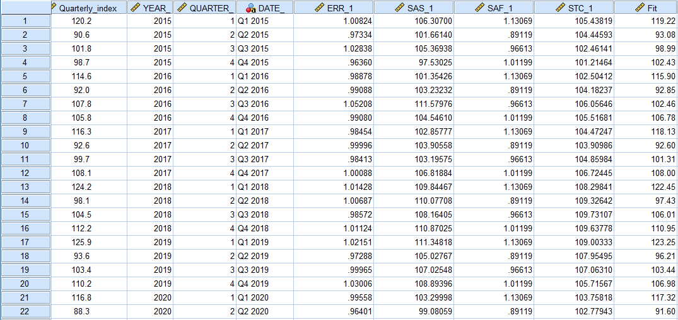
SPSS solution (7/9)
SPSS adds new variables to your data set. Figure 10.76 shows the ones that we selected during the execution process.

Slide 36
SPSS solution (8/9)
SPSS has created four new variables and they are called SAS_1, SAF_1, STC_1 and ERR_1. The interpretation, as per SPSS Help file, is as follows:
SAS. Seasonally adjusted series, representing the original series with seasonal variations removed. Working with a seasonally adjusted series, for example, allows a trend component to be isolated and analyzed independent of any seasonal component.
SAF. Seasonal adjustment factors, representing seasonal variation. For the multiplicative model, the value 1 represents the absence of seasonal variation; for the additive model, the value 0 represents the absence of seasonal variation.
STC. Smoothed trend-cycle component, which is a smoothed version of the seasonally adjusted series that shows both trend and cyclic components.
ERR. The residual component of the series for a particular observation.
If you compare these column values with Example 10.16, then:
STC variable is comparable to Column E (Trend component) in Figure 10.65.
SAF variable is comparable to cells K24:K27 (Typical Seasonal Index) in Figure 10.66.
SAS variable is comparable to Column F (Seasonally Adjusted series) in Figure 10.67.

Slide 37
SPSS solution (9/9)
You will notice that the numbers from Excel do not match 100% the numbers from SPSS. The reason is that SPSS uses slightly more sophisticated method in order to make it universally applicable to both seasonal and cyclical components.
For example, the method for trend that SPSS uses, is not a simple trend method but a combined centred moving average method that incorporates both T and C component together. This has a “knock on” effect on both SAS and SAF variable, hence small differences from our Excel solution.
If you compare these column values with Example 10.16, then:
STC variable is comparable to Column E (Trend component) in Figure 10.65.
SAF variable is comparable to cells K24:K27 (Typical Seasonal Index) in Figure 10.66.
SAS variable is comparable to Column F (Seasonally Adjusted series) in Figure 10.67.
You will notice that the numbers from Excel do not match 100% the numbers from SPSS. The reason is that SPSS uses slightly more sophisticated method in order to make it universally applicable to both seasonal and cyclical components.

Slide 38
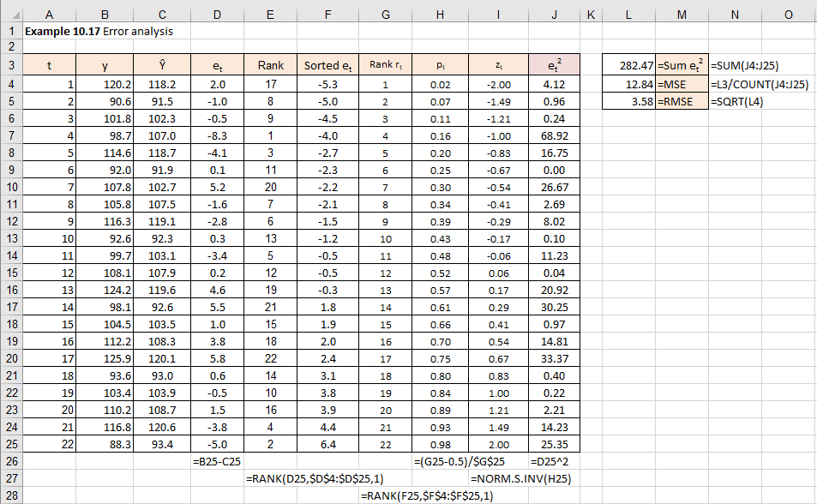
Error measurement (1/6)
We will now calculate the errors, as well as the squared errors for Example 10.16. From there, we will check if the errors are random, if they are distributed as per normal distribution and what is the mean square error (MSE), as well as the root mean square error (RMSE). All the calculations have already been explained, so we will use Excel to perform these tasks.
Example 10.17

Slide 39
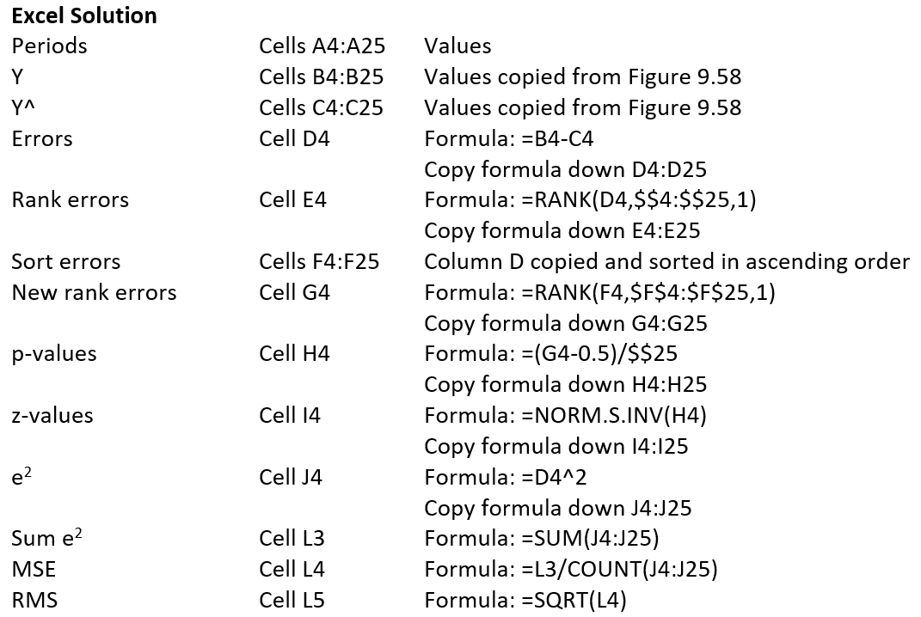
Error measurement (2/6)

Slide 40
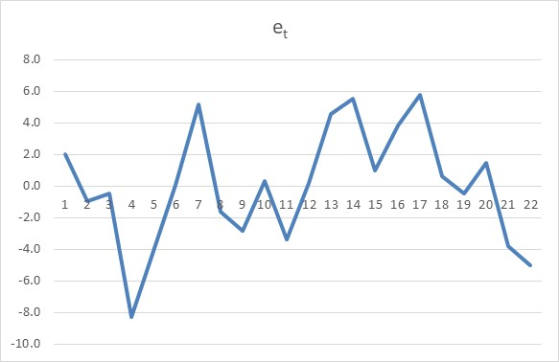
Error measurement (3/6)
As the first step, we will plot the errors from column B in Figure 10.73. The plot is given in Figure 10.78.
As we can see from Figure 10.78 they appear to be random, which means that our model modelled the actual data well. However, the fact that they appear random is not enough. We need to do some more tests.
Figure 10.78

Slide 41
Error measurement (4/6)
The column E in Figure 10.77 shows the rank of errors from column D and they were ranked from the smallest to the largest error.
In column F in Figure 10.77 we copied the errors from column D, but this time they were ranked using Excel sorting facility to put them in ascending order.
Column G shows that they are now ranked from the smallest to the largest error.
  This rank is labelled r_{t}
The same rank values r_{t} are used to calculate the cumulative probabilities for this time series. The probabilities are calculated using a simple equation (10.25):
Where r_{t} is the rank and n is the number of errors.

Slide 42
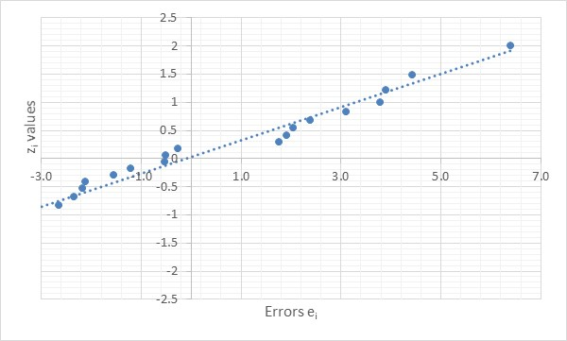
Error measurement (5/6)
As the second step, we will see if our errors follow normal distribution. The final step in the calculation process is to calculate the z-values for every p_{t}. In other words, we will use the Excel cumulative distribution function (=NORM.S.INV()), or total area under the curve to the left of every p_{t} point. As we have demonstrated above, this is all easily executed in Excel. Finally, we can create a plot of errors e_{t} vs the z_{t} values in a scatter diagram. Figure 10.79 shows the plot.
As we can see, our line fits very well almost all the errors and all the errors follow the straight line, which means that they are normally distributed.
This is another confirmation that our model is fitting data well.
Figure 10.79

Slide 43
Error measurement (6/6)
We also calculated the Mean Square Error (MSE):
  MSE = 10.489
To put this error in the same units as the original time series (which happen to be indices), we take the square root of that value which gives the Root Mean Square Error (RMSE):
  RMSE = 3.24
This means that on average our fitted model is “adrift” from the original time series 3.24 index points.
Figure 10.79 showed us that we have a good fit, but now we were also able to quantify how good this fit is.

Slide 44
Prediction interval (1/7)
Equation (10.16) already defined how to use the standard error of the estimate SE_{y,ŷ} (or, let’s call it SEE) to calculate where the true value of y might be. We called this a prediction interval. We also said that for the larger time series, we can use either the t-value or z-values to define the prediction interval. So, our prediction interval, if we use the most generic format, is defined as:
Because we said that our errors must follow the normality assumption, we will use one “trick” which enables us under these conditions to say that RMS (root mean square error) is effectively the same as SEE (the standard error of estimate). You can compare equation (9.15) with (10.9). This means that equation (10.26) becomes:

Slide 45
Prediction interval (2/7)
Out of convenience, let’s label the expression z × RMS in equation (10.27) as k. In this case, the equation (10.27) becomes:
The above equation (10.28) is perfectly suited for one step-ahead forecasts. The ex-post forecasts that fit the historical time series are effectively one-step ahead forecasts, so it is appropriate to use this approach to estimate the confidence interval for the historical data.
However, when we come to the last observation in the time series and we forecast the future values, we are producing forecasts for multiple steps ahead (because we reached the last actual time series observation).

Slide 46
Prediction interval (3/7)
As we already know, it is intuitive to assume that as we go further into the future, the prediction interval is going to get wider and wider. Unfortunately, without going into some very complex methods which are beyond the scope of this textbook, there are no easy analytic methods to apply this principle to seasonal data. However, we can use a workaround, which is an empirical method.
The empirical method that could be used is as follows. We take h to be the number of steps ahead for which we are producing forecasts, i.e. h = 1, 2, 3, … If we multiply the MSE by h, this will intuitively address the need to make the prediction interval going wider as we move further into the future. In this case the RMS is calculated using the following equation:
The factor k in the prediction interval now becomes a dynamic value, subject to the number future steps h. This means our equation (9.28) keeps the shape, but it is “enhanced” by the number of steps h:

Slide 47
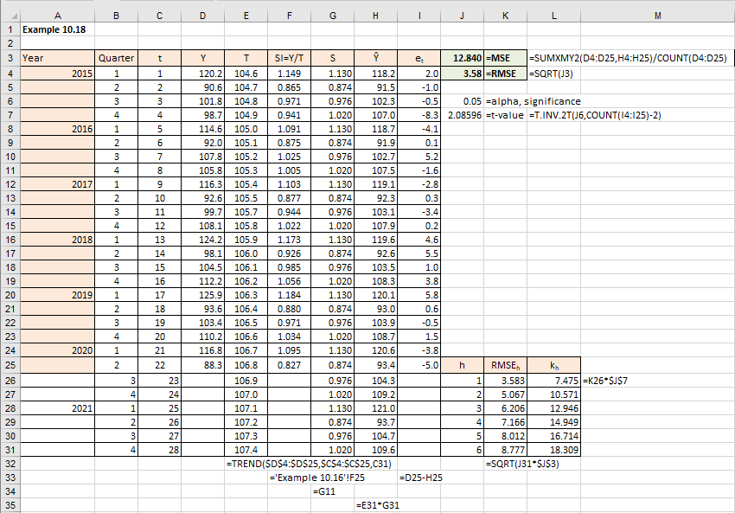
Prediction interval (4/7)
Example 10.18

Slide 48
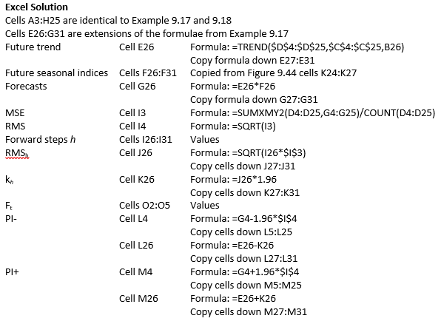
Prediction interval (5/7)

Slide 49
Prediction interval (6/7)
Although our time series consist of only 22 observations and we should have used t-values rather than z-values to calculate the prediction interval, the principles of calculation are identical and for the sake of simplicity we used 1.96 as the 95% confidence value for z.
There is no need to explain the calculations up until column H, as we already covered this in Example 9.16. Cells I3 and I4 contain the MSE and RMS, and we are also familiar with how to calculate them. Cells L4:M25 were also explained previously. What is new, are the cells I25:K31. This is where the equations (10.29) and (10.30) were applied to get the dynamic value of k_{h}. Using this calculated value of k_{h} in cells K26:K31, we can now calculate the future prediction interval, as in cells L26:M31. To show how well our model fits the actual data, as well as the future forecasts and their prediction interval, we put all these variables in one graph in Figure 10.81.

Slide 50
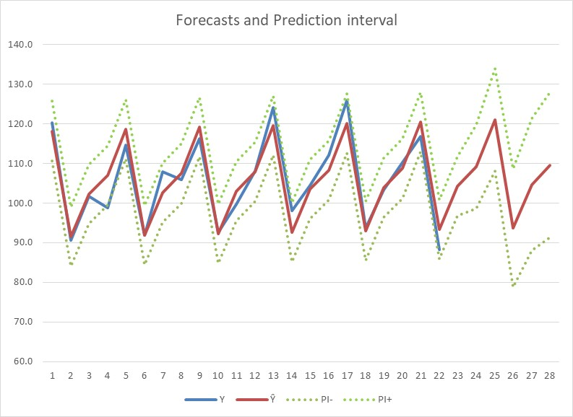
Prediction interval (7/7)
As we can see from Figure 10.81, the future prediction interval complies with the intuitive expectation that it should get wider the further into the future we extrapolate our forecasts.
Figure 10.81

Slide 51
Conclusion
Part 1 and 2 presentations provide a set of tools which can be used to analyse time series data:
Seasonal models
Forecasting errors
Prediction intervals

